Slide 1






Foundations of
Quantum Information Science (QIS 101)
Dave Biersach
Brookhaven National Laboratory
dbiersach@bnl.gov
Session 17
Simulation and Modelling

Slide 2
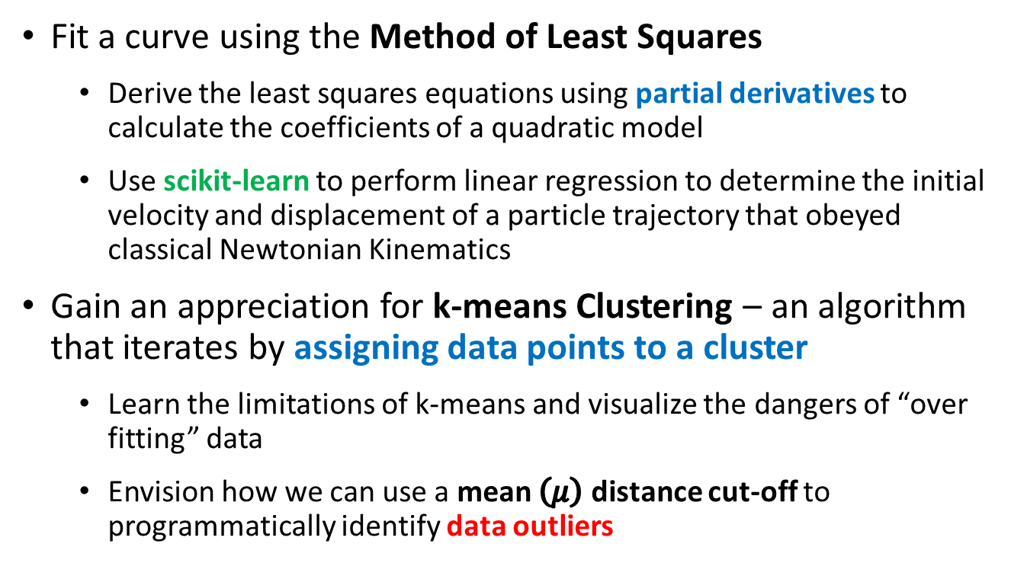
Session 17 – Goals
Fit a curve using the Method of Least Squares
Derive the least squares equations using partial derivatives to calculate the coefficients of a quadratic model
Use scikit-learn to perform linear regression to determine the initial velocity and displacement of a particle trajectory that obeyed classical Newtonian Kinematics
Gain an appreciation for k-means Clustering – an algorithm that iterates by assigning data points to a cluster
Learn the limitations of k-means and visualize the dangers of “over fitting” data
Envision how we can use a mean $\left(μ\right)$ distance cut-off to programmatically identify data outliers

Slide 3
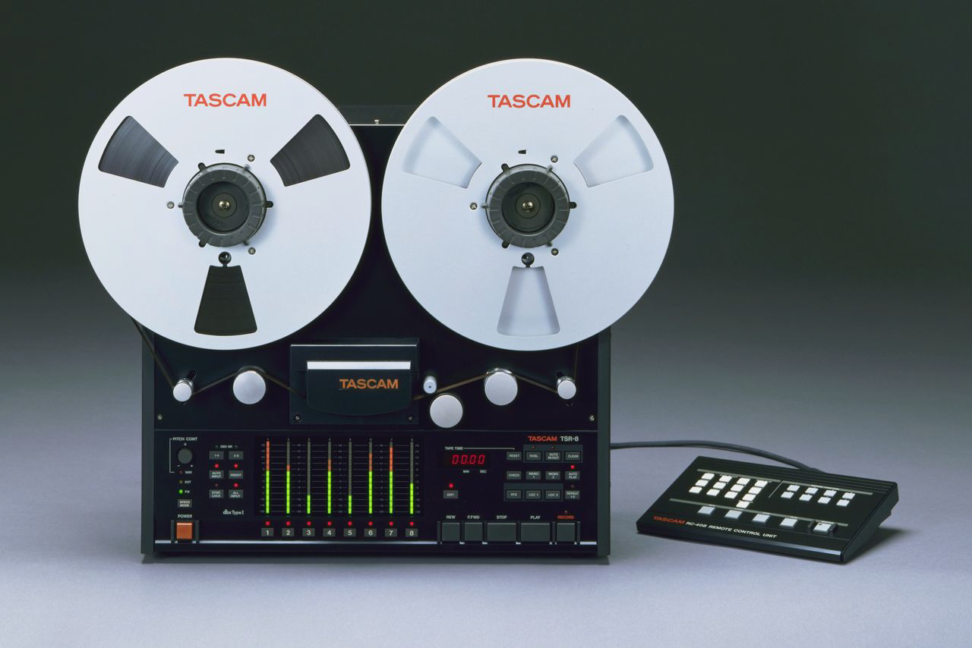
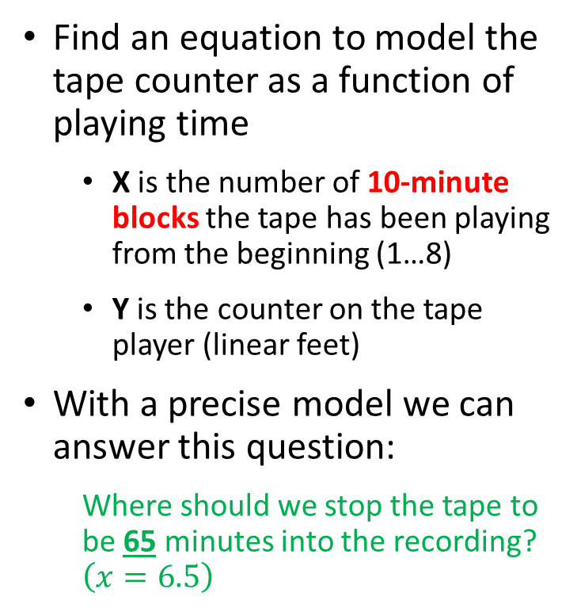
Modelling
Find an equation to model the tape counter as a function of playing time
X is the number of 10-minute blocks the tape has been playing from the beginning (1…8)
Y is the counter on the tape player (linear feet)
With a precise model we can answer this question:
Where should we stop the tape to be 65 minutes into the recording? $\left(x=6.5\right)$

Slide 4
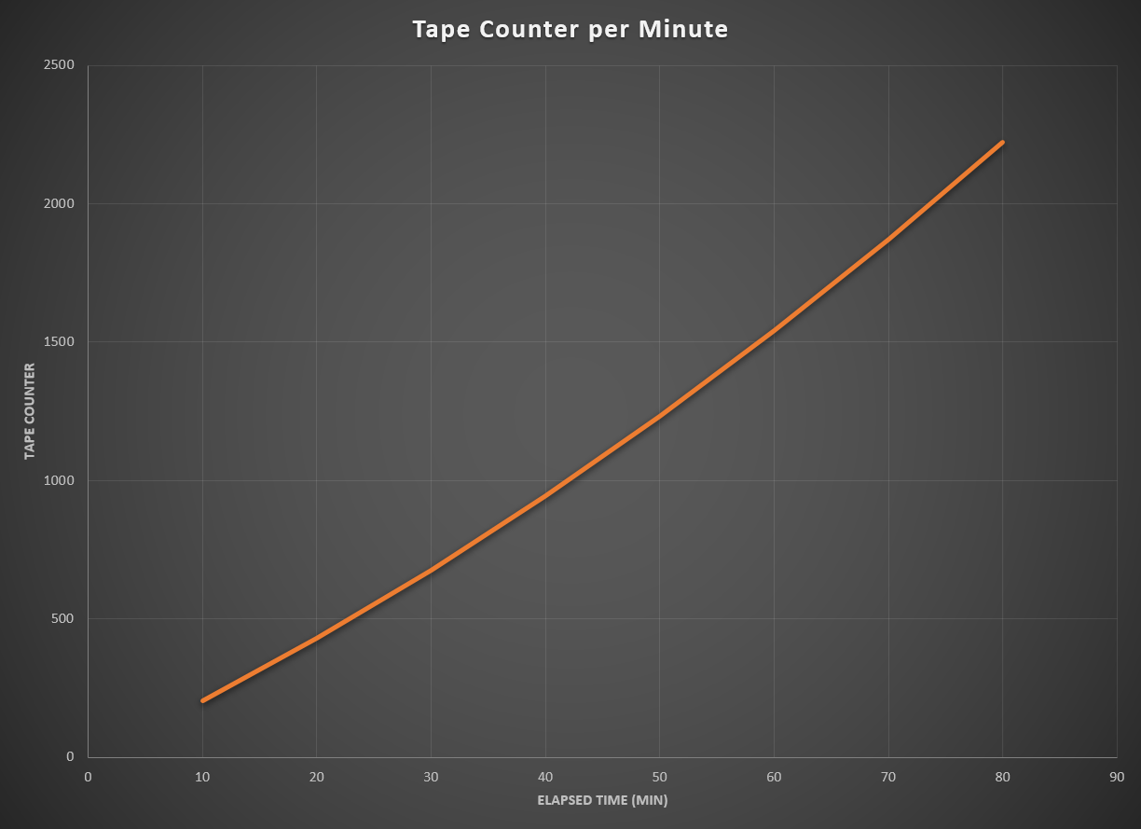
Modelling
$$Assume$$
$$y=ax^{2}+bx+c$$

Slide 5
Method of Least Squares
$$Minimize S= \sum_{i=1}^{n}{{\left[y_{i}−\left(ax_{i}^{2}+bx_{i}+c\right)\right]}^{2}}$$
$$\left(y−{ax}^{2}−bx−c\right)\left(y−{ax}^{2}−bx−c\right)$$
$$y^{2}−ax^{2}y−bxy−cy$$
$$−ax^{2}y +a^{2}x^{4}+abx^{3}+acx^{2}$$
$$−bxy +abx^{3} +b^{2}x^{2}+bcx$$
$$−cy +acx^{2} +bcx+c^{2}$$
$$S=y^{2}−2ax^{2}y−2bxy−2cy+a^{2}x^{4}+2abx^{3}+2acx^{2}+b^{2}x^{2}+2bcx+c^{2}$$
Note: we will set aside the summation operator for now…

Slide 6
Method of Least Squares
$$Minimize S= \sum_{i=1}^{n}{{\left[y_{i}−\left(ax_{i}^{2}+bx_{i}+c\right)\right]}^{2}}$$
$$S=y^{2}−2ax^{2}y−2bxy−2cy+a^{2}x^{4}+2abx^{3}+2acx^{2}+b^{2}x^{2}+2bcx+c^{2}$$
For S to have a minimum, these partial derivatives must exist:
$$\frac{∂S}{∂a}=0,\frac{∂S}{∂b}=0,\frac{∂S}{∂c}=0$$
$$\frac{∂S}{∂a}=−2x^{2}y+2ax^{4}+2bx^{3}+2cx^{2}=0$$
$$\frac{∂S}{∂b}=−2xy+2ax^{3}+2bx^{2}+2cx=0$$
$$\frac{∂S}{∂c}=−2y+2ax^{2}+2bx+2c=0$$

Slide 7
Method of Least Squares
$$Minimize S= \sum_{i=1}^{n}{{\left[y_{i}−\left(ax_{i}^{2}+bx_{i}+c\right)\right]}^{2}}$$
$$\frac{∂S}{∂a}=−2x^{2}y+2ax^{4}+2bx^{3}+2cx^{2}=0$$
Divide through by the GCD of all terms
Move all terms not containing a, b, or c
to the RHS
$$\left(x^{4}\right)a+\left(x^{3}\right)b+\left(x^{2}\right)c=x^{2}y$$
$$\frac{∂S}{∂b}=−2xy+2ax^{3}+2bx^{2}+2cx=0$$
$$\left(x^{3}\right)a+\left(x^{2}\right)b+\left(x\right)c=xy$$
$$\frac{∂S}{∂c}=−2y+2ax^{2}+2bx+2c=0$$
$$\left(x^{2}\right)a+\left(x\right)b+c=y$$

Slide 8
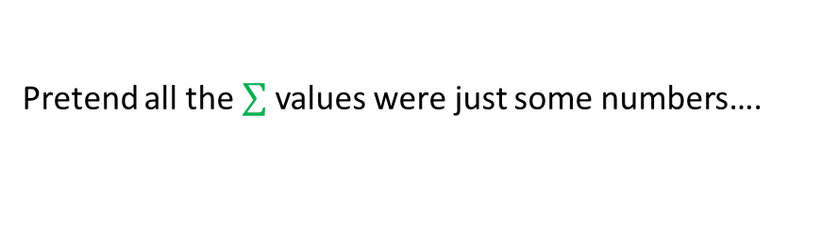
Method of Least Squares
$$Minimize S= \sum_{i=1}^{n}{{\left[y_{i}−\left(ax_{i}^{2}+bx_{i}+c\right)\right]}^{2}}$$
$$\sum_{i=1}^{n}{\left(1\right)c=\left(n\right)c}$$
Reintroduce the operators
But these values are just sums of the known (observed) values!
$$\left(\sum{x_{i}^{4}}\right)a+\left(\sum{x_{i}^{3}}\right)b+\left(\sum{x_{i}^{2}}\right)c = \left(\sum{x_{i}^{2}y_{i}}\right)$$
$$\left(\sum{x_{i}^{3}}\right)a+\left(\sum{x_{i}^{2}}\right)b+\left(\sum{x_{i}}\right)c = \left(\sum{x_{i}y_{i}}\right)$$
$$\left(\sum{x_{i}^{2}}\right)a+\left(\sum{x_{i}}\right)b+ \left(n\right)c = \left(\sum{y_{i}}\right)$$
Pretend all the values were just some numbers….

Slide 9
Method of Least Squares
$$Minimize S= \sum_{i=1}^{n}{{\left[y_{i}−\left(ax_{i}^{2}+bx_{i}+c\right)\right]}^{2}}$$
This is just a system of 3 linear equations and 3 unknowns!
$$\left(4\right)a+ \left(5\right)b+\left(−2\right)c=\left(−14\right)$$
$$\left(7\right)a+\left(−1\right)b+ \left(2\right)c= \left(42\right)$$
$$\left(3\right)a+ \left(1\right)b+ \left(4\right)c= \left(28\right)$$

Slide 10
Method of Least Squares
$$Minimize S= \sum_{i=1}^{n}{{\left[y_{i}−\left(ax_{i}^{2}+bx_{i}+c\right)\right]}^{2}}$$
This is just a system of 3 linear equations and 3 unknowns!
$$\left(\sum{x_{i}^{4}}\right)a+\left(\sum{x_{i}^{3}}\right)b+\left(\sum{x_{i}^{2}}\right)c = \left(\sum{x_{i}^{2}y_{i}}\right)$$
$$\left(\sum{x_{i}^{3}}\right)a+\left(\sum{x_{i}^{2}}\right)b+\left(\sum{x_{i}}\right)c = \left(\sum{x_{i}y_{i}}\right)$$
$$\left(\sum{x_{i}^{2}}\right)a+\left(\sum{x_{i}}\right)b+ \left(n\right)c = \left(\sum{y_{i}}\right)$$
Coefficient Matrix
Value Vector

Slide 11
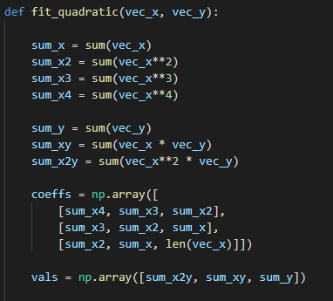
Open quadratic_regression.py
$$Minimize S= \sum_{i=1}^{n}{{\left[y_{i}−\left(ax_{i}^{2}+bx_{i}+c\right)\right]}^{2}}$$
$$\left(\sum{x_{i}^{4}}\right)a+\left(\sum{x_{i}^{3}}\right)b+\left(\sum{x_{i}^{2}}\right)c = \left(\sum{x_{i}^{2}y_{i}}\right)$$
$$\left(\sum{x_{i}^{3}}\right)a+\left(\sum{x_{i}^{2}}\right)b+\left(\sum{x_{i}}\right)c = \left(\sum{x_{i}y_{i}}\right)$$
$$\left(\sum{x_{i}^{2}}\right)a+\left(\sum{x_{i}}\right)b+ \left(n\right)c = \left(\sum{y_{i}}\right)$$

Slide 12
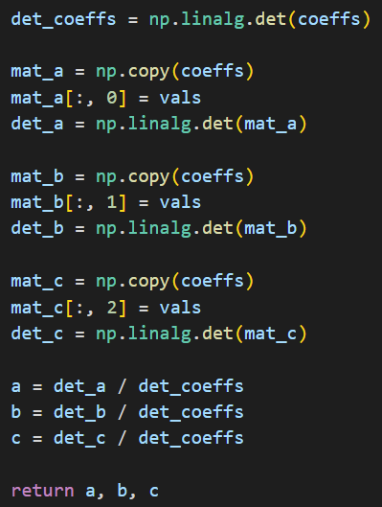
View quadratic_regression.py
①
②
Overlay the value vector onto the coefficients matrix
③
④
⑤
⑥
We will use Cramer's Rule to solve this 3x3 system of equations!

Slide 13
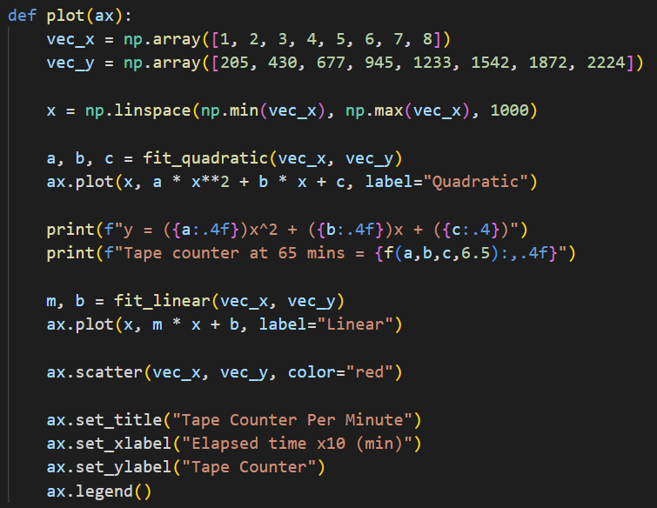
View quadratic_regression.py
①
②
③
④
⑤
⑥
⑦

Slide 14
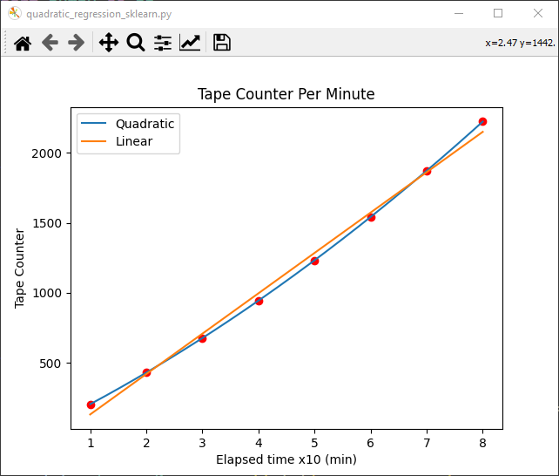
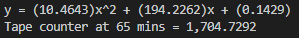
Run quadratic_regression.py

Slide 15
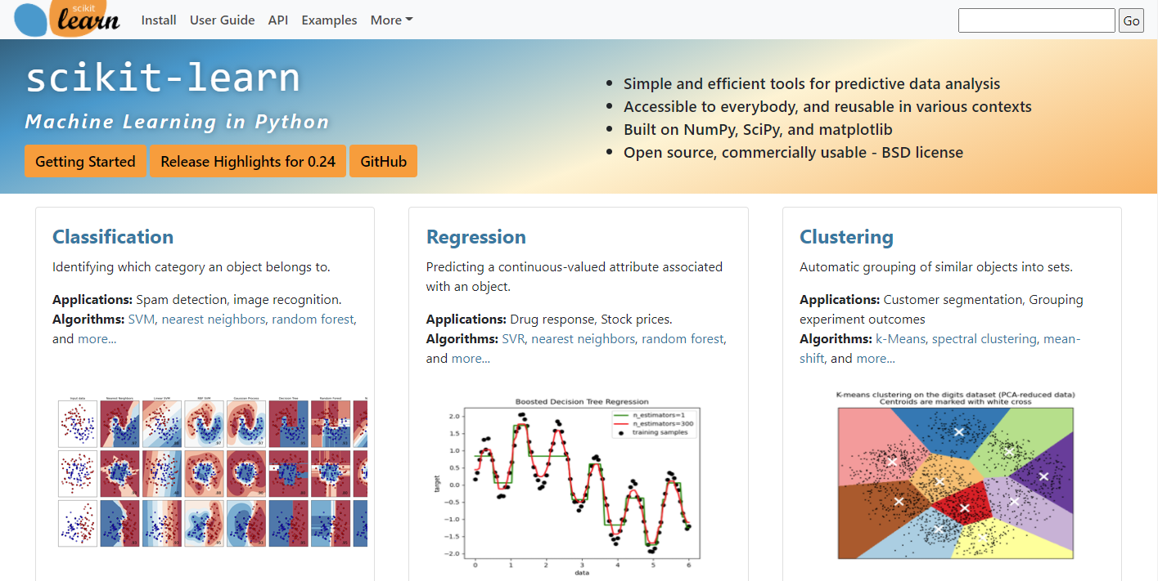
Machine Learning in Python
https://scikit-learn.org

Slide 16
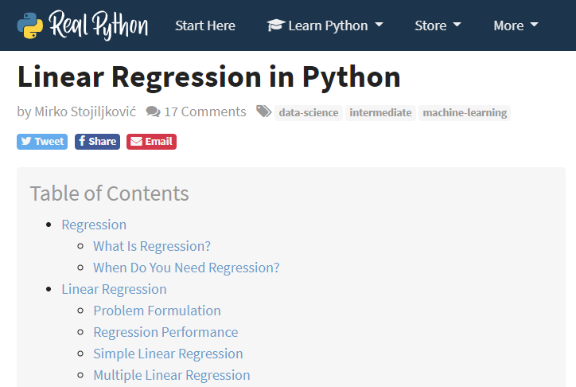
Linear Regression in Python
https://realpython.com/linear-regression-in-python

Slide 17
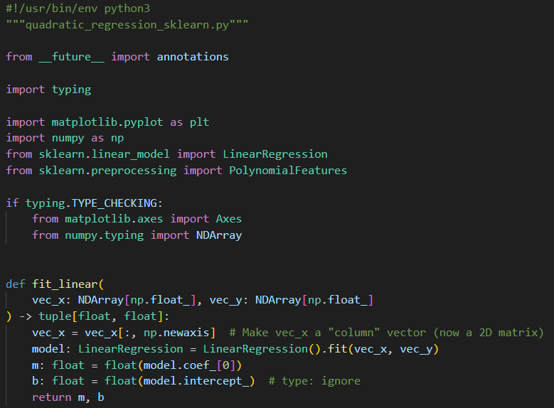
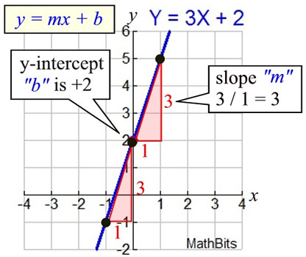
Open quadratic_regression_sklearn.py
①
shape [8,] is not the same as [8,1]
②
③
④
⑤
⑥

Slide 18
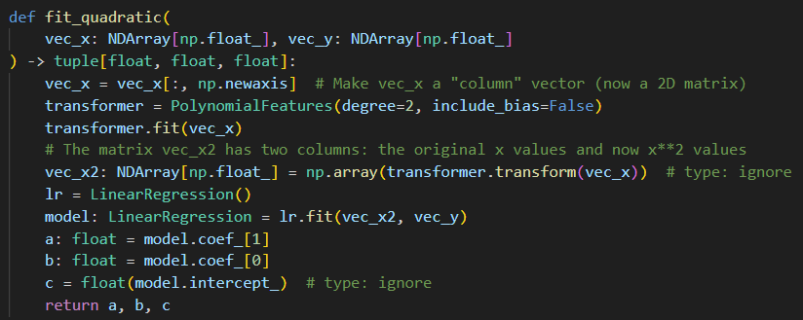
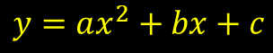
View quadratic_regression_sklearn.py
①
②
③
④
⑤
⑥
⑦
⑧
$$y=ax^{2}+bx+c$$
⑨
⑩

Slide 19
Run quadratic_regression_sklearn.py

Slide 20
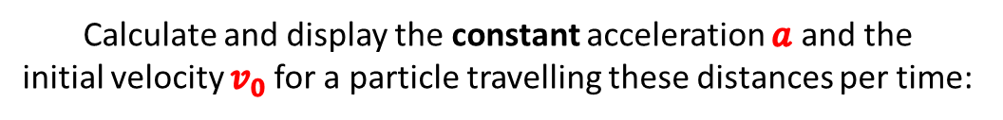
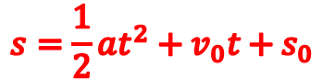
Newtonian Kinematics
Calculate and display the constant acceleration $a$ and the
initial velocity $v_{0}$for a particle travelling these distances per time:
Use the method of least squares to fit an appropriate kinematic equation that governs the trajectory of this particle
Assume SI units
$$s=\frac{1}{2}at^{2}+v_{0}t+s_{0}$$

Slide 21
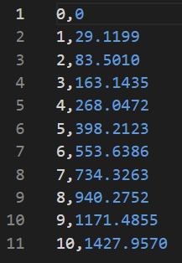
Open kinematics_regression.csv
CSV = Comma Separated Value (text file)
①

Slide 22
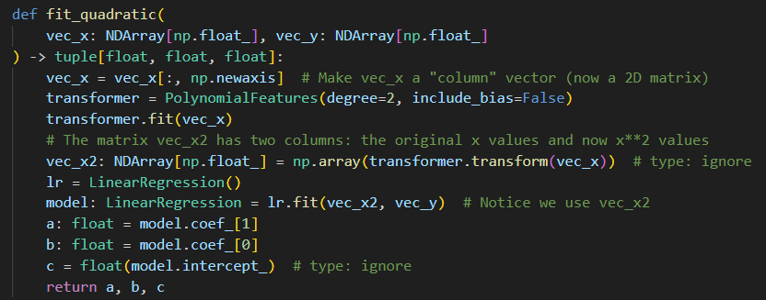
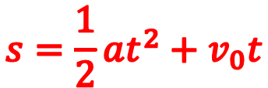
Open kinematics_regression.py
$$s=\frac{1}{2}at^{2}+v_{0}t$$

Slide 23
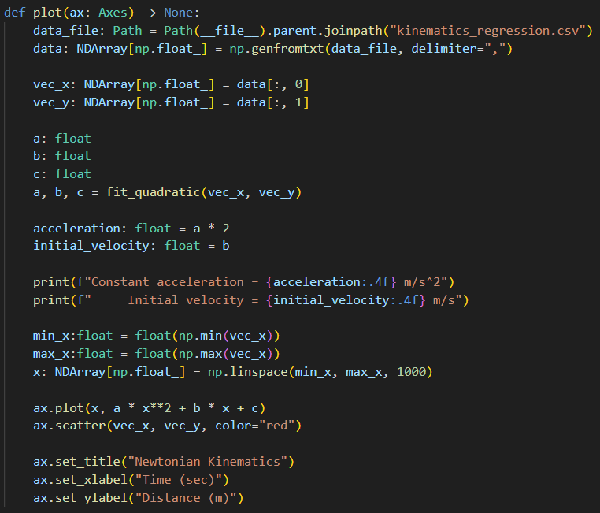
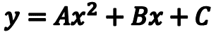
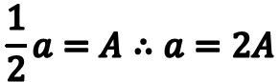
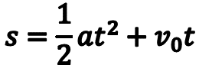
View kinematics_regression.py
①
②
③
④
$$y=Ax^{2}+Bx+C$$
⑤
$$s=\frac{1}{2}at^{2}+v_{0}t$$
$$\frac{1}{2}a=A∴a=2A$$
⑥
⑦
⑧

Slide 24
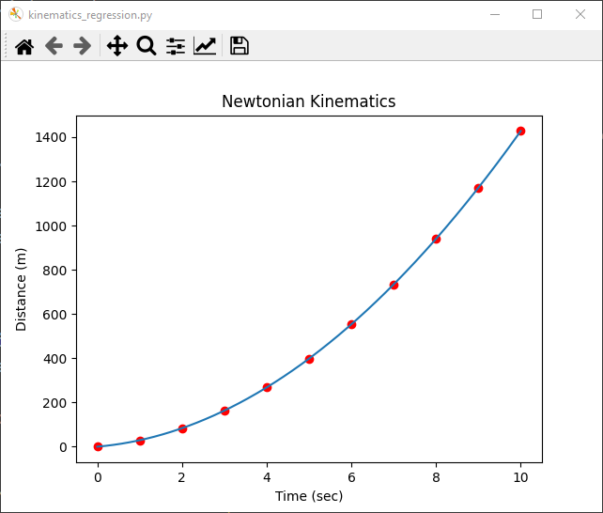
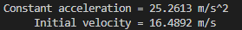
Run kinematics_regression.py

Slide 25
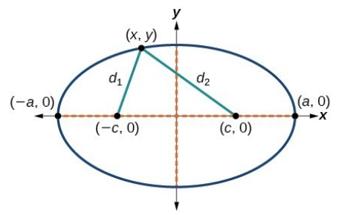
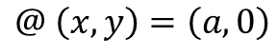
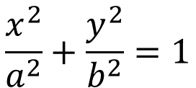
Deriving the Equation of an Ellipse
$$d_{2}$$
C
$$\frac{x^{2}}{a^{2}}+\frac{y^{2}}{b^{2}}=1$$
C
a
$$d_{1}$$
$$d_{1}+d_{2}=constant$$
$$@ \left(x,y\right)=\left(a,0\right)$$
$$d_{1}=\left(−c,0\right)→\left(a,0\right)=a−\left(−c\right)=a+c$$
$$d_{2}=\left(c,0\right)→\left(a,0\right)=a−\left(c\right)=a−c$$
$$\left(a+c\right)+\left(a−c\right)=constant=2a$$

Slide 26
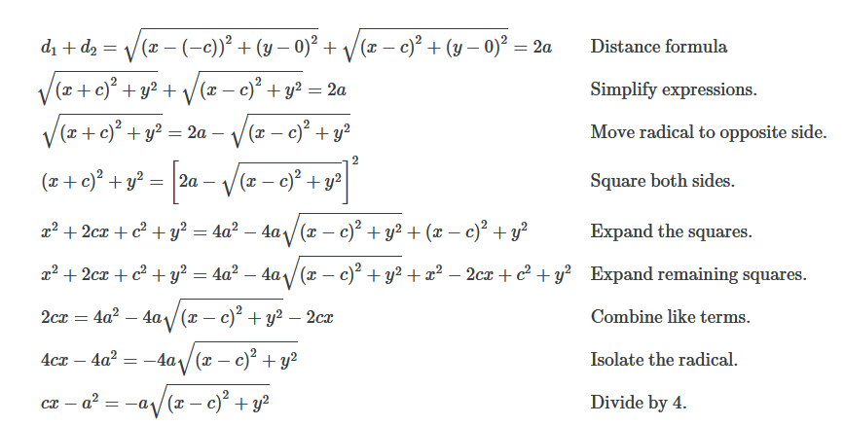
Deriving the Equation of an Ellipse

Slide 27
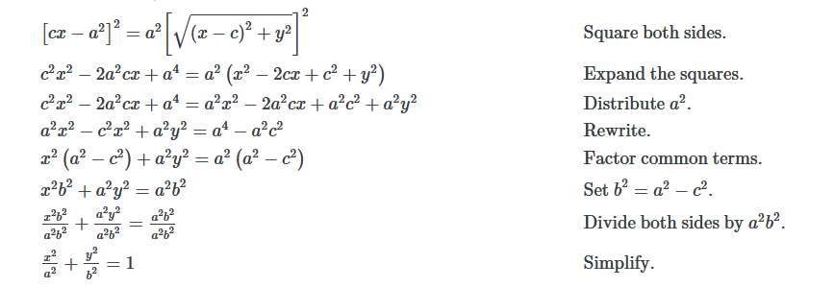
Deriving the Equation of an Ellipse

Slide 28
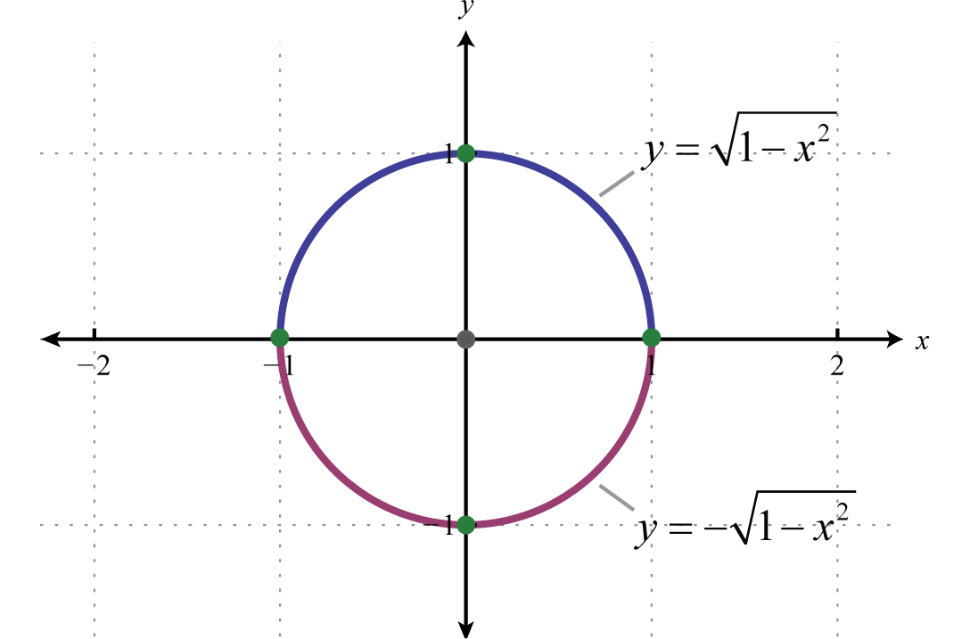
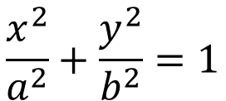
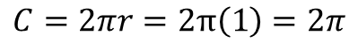
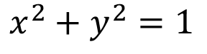
The Perimeter of an Ellipse
$$\frac{x^{2}}{a^{2}}+\frac{y^{2}}{b^{2}}=1$$
$$x^{2}+y^{2}=1$$
What is the formula for the circumference of an ellipsis?
$$C=2πr=2π\left(1\right)=2π$$

Slide 29
The Perimeter of an Ellipse
$$\frac{x^{2}}{a^{2}}+\frac{y^{2}}{b^{2}}=1$$
$$x=a\cos{θ}$$
$$L=\int{ds}$$
Arc Length
$$y=b\sin{θ}$$
$$\frac{ds}{dθ}=\sqrt{x^{′}{\left(θ\right)}^{2}+y^{′}{\left(θ\right)}^{2}}$$
$$\frac{{\left(a\cos{θ}\right)}^{2}}{a^{2}}+\frac{{\left(b\sin{θ}\right)}^{2}}{b^{2}}=1$$
$$L=\int{\sqrt{x^{′}{\left(θ\right)}^{2}+y^{′}{\left(θ\right)}^{2}}}dθ$$
$$\frac{{a^{2}\left(\cos{θ}\right)}^{2}}{a^{2}}+\frac{{b^{2}\left(\sin{θ}\right)}^{2}}{b^{2}}=1$$
$$L=\int{\sqrt{a^{2}\sin^{2}\left(θ\right)+b^{2}\cos^{2}\left(θ\right)}}dθ$$
$$\cos^{2}\left(θ\right)+\sin^{2}\left(θ\right)=1$$
$$perimeter=\int_{0}^{2π}{\sqrt{a^{2}\sin^{2}\left(θ\right)+b^{2}\cos^{2}\left(θ\right)}ⅆθ}$$
An ellipse is just a circle where x and y coordinates are scaled independently
We can only numerically estimate this integral!

Slide 30
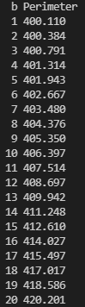
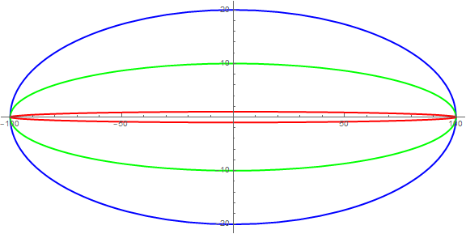
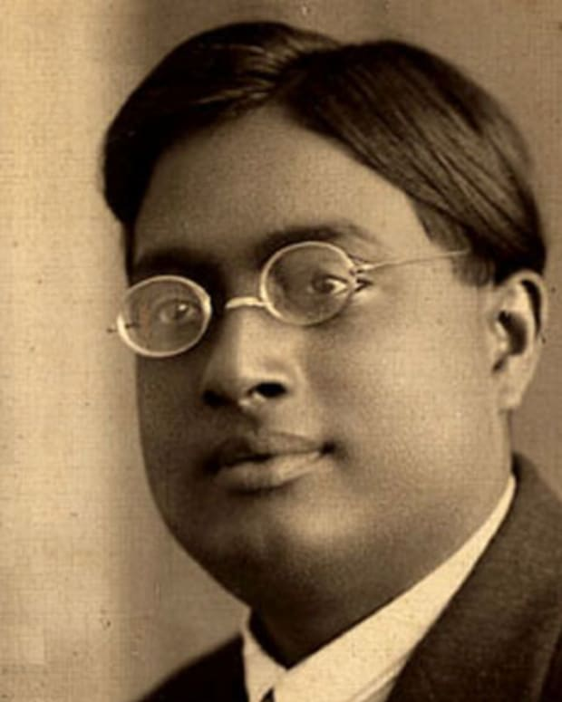
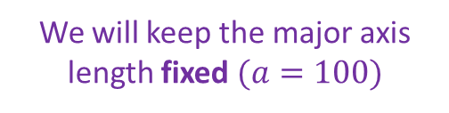
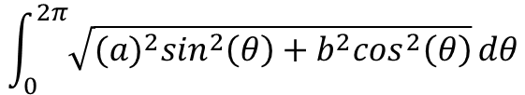
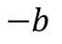
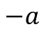
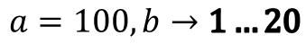
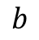
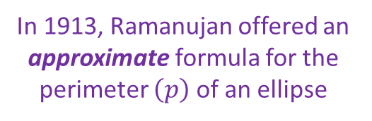
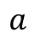
The Perimeter of an Ellipse
$$\frac{x^{2}}{a^{2}}+\frac{y^{2}}{b^{2}}=1$$
$$x=a\cos{θ}$$
In 1913, Ramanujan offered an approximate formula for the perimeter $\left(p\right)$ of an ellipse
$$y=b\sin{θ}$$
$$a=100,b→1…20$$
$$b$$
$$≈\left(a+b\right)\left(1+\frac{3h}{10+\sqrt{4−3h}}\right)π$$
$$h=\frac{a−b}{a+b}$$
$$−a$$
$$a$$
$$−b$$
$$\int_{0}^{2π}{\sqrt{{(a)}^{2}\sin^{2}\left(θ\right)+b^{2}\cos^{2}\left(θ\right)}}dθ$$
We will keep the major axis length fixed $(a=100)$
Srinivasa Ramanujan
(1887-1920)

Slide 31
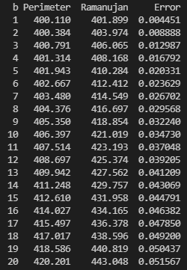
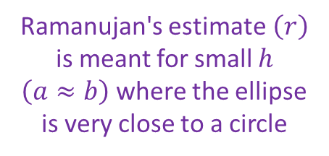
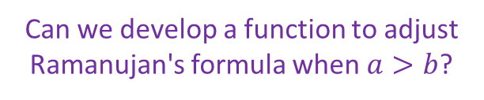




The Perimeter of an Ellipse
Ramanujan's estimate$\left(r\right)$ is meant for small $h$ $\left(a≈b\right)$ where the ellipse is very close to a circle
$$a=100,b→1…20$$
$$h=\frac{a−b}{a+b}$$
$$p=\int_{0}^{2π}{\sqrt{{(a)}^{2}\sin^{2}\left(θ\right)+b^{2}\cos^{2}\left(θ\right)}}dθ$$
$$r=\left(a+b\right)\left(1+\frac{3h}{10+\sqrt{4−3h}}\right)π$$
Ramanujan's estimate was helpful because scientists did not have high-speed computers to numerically estimate the integral like we do today
Can we develop a function to adjust Ramanujan's formula when $a>b$?
$$err=\left|\frac{\left(r−p\right)}{r}\right|$$

Slide 32

Open ellipse_perimeter.py
For an ellipse with major axis $= a$and minor axis $= b$, consider the following two functions:
d_s() returns the differential unit of arc length on the perimeter of the ellipse at the passed-in value for $θ$
ram() returns Ramanujan's estimate for the perimeter of the ellipse
The code will then fit a quadratic curve through the points containing the relative error between the perimeter integral value and Ramanujan's estimate
This fitted quadratic terms will then be used to adjust Ramanujan's estimates to better match the values of the arc length integral

Slide 33

Open ellipse_perimeter.py
①
②
③
③
④
Ramanujan's polynomial is always a bit larger than the polar arc length integral
⑤
⑥
⑦
⑧

Slide 34

Run ellipse_perimeter.py

Slide 35

Run ellipse_perimeter.py

Slide 36
The Perimeter of an Ellipse
Astronomy - Kepler's first law of planetary motion states that the planets move in elliptical orbits and hence knowing its perimeter is crucial in understanding satellite mechanics and the paths of comets
Optics - Ellipsoidal mirrors, such as those used in telescopes or satellite dishes, are designed to focus light at a specific point, providing high-resolution images or directing signals
Heat Transfer - Ellipses model isothermal curves in solid bodies and shapes with uniform heat generation
Geophysics: The Earth is approximately an oblate ellipsoid with slight flattening at the poles and bulging at the equator. Understanding the shape of the Earth is crucial for mapping, navigation (GPS), and geodetic surveys

Slide 37

k-means Clustering
k-means clustering aims to partition n observations into k clusters (where each cluster has its own $μ$point)
Each observation is assigned to the cluster whose $μ$point is closest to that observation’s point
The problem is computationally difficult (NP-hard); however, there are efficient heuristic algorithms that are commonly employed and converge quickly to a local optimum
The term "k-means" was first used by James MacQueen in 1967, though the idea goes back to Hugo Steinhaus in 1957
A more efficient version was published Hartigan and Wong in 1979

Slide 38

k-means Clustering

Slide 39

k-means Clustering

Slide 40

k-means Clustering
A one-to-many mapping between clusters and data points
A cluster is a set of one or more unique data points
Every data point must be assigned to only one cluster at a time
Data points are initially assigned to clusters in a round-robin fashion
The $μ$point of each cluster is its geometric center (centroid) calculated by taking the average value (in each dimension) of only the data points assigned to that cluster
Assignments can change the $μ$ points… which then can change the assignments… which then can change the $μ$ points… which then can change the assignments… which then can…

Slide 41





k-means Clustering
$μ$points
assignments

Slide 42

k-means Clustering
The algorithm uses two phases per round:
For each cluster, a new centroid ($μ$point) is calculated using the current data point assignments
If the new $μ$≠ current $μ$ then move cluster so current $μ$ = new $μ$
For each data point, find the cluster which has the closest $μ$point using Pythagorean distance formula
If necessary, reassign the data point to the new closest cluster - subject to constraint that every cluster must have one data point
The algorithm repeats phases #1 and #2 until no cluster moves and no data point is reassigned
When the algorithm reaches steady-state the cluster has “converged”

Slide 43

Open cluster_samples.csv
Cartesian X,Y
data points
This point is a
data outlier

Slide 44



Open k_means.py
Global variables are declared outside the scope of any function
Every datapoint has a Cartesian $\left(x,y\right)$ coordinate
Every datapoint belongs to just one cluster
The $μ$ point (center) of a cluster is the average of the coordinates $\left(x, y\right)$of all the datapoints that belong to that cluster

Slide 45
View k_means.py
The number of datapoints belonging to a cluster is its population

Slide 46

View k_means.py
gcf() = "Get Current Figure"
①
②
③
④
⑤
⑥
⑦
⑧
⑨
⑩

Slide 47


View k_means.py
①
②
③
④
⑤
⑥
$$\left(x,y\right)$$
⑦
⑧

Slide 48
View k_means.py
①
②
③
Datapoints are assigned to an initial cluster in a round-robin fashion
④
⑤
⑥

Slide 49

View k_means.py
①
②
③
④
⑤
⑥
"s" = A square marker

Slide 50
View k_means.py
①
②
"n" = Next step
③
④
⑤
⑥
⑦

Slide 51

View k_means.py
①
②
③
④
⑤
⑥
⑦
⑧
⑨
⑩

Slide 52

View k_means.py
①
②
③
④
⑤
⑥
⑦
⑧
⑨
⑩

Slide 53


Run k_means.py
Data points are initially assigned in a round-robin fashion to an arbitrary cluster
All cluster $μ$points start at (0,0)
Press n to single step the cluster algorithm

Slide 54



Run k_means.py
Data points are assigned to the cluster with closest $μ$point
The algorithm is trying to converge to three clusters
Cluster $μ$points have moved
Press n to single step the cluster algorithm

Slide 55

Run k_means.py
Press n to single step the cluster algorithm

Slide 56

Run k_means.py
Press n to single step the cluster algorithm

Slide 57

Run k_means.py
Press n to single step the cluster algorithm

Slide 58

Run k_means.py
No data points have changed their cluster assignment
No cluster $μ$points have moved

Slide 59

k-means Clustering

Slide 60

n-Dimensional k-means Clustering

Slide 61


Edit k_means.py
①
This point is a
data outlier

Slide 62

Run k_means.py
This is a data outlier
Press n to single step the cluster algorithm

Slide 63

Run k_means.py
The outlier has skewed the red cluster

Slide 64

Edit k_means.py
①

Slide 65

Run k_means.py
Press n to single step the cluster algorithm

Slide 66

Run k_means.py
The outlier has skewed the blue cluster

Slide 67

Edit k_means.py
①

Slide 68

Run k_means.py
Press n to single step the cluster algorithm

Slide 69

Run k_means.py
The outlier is now in its own cluster ☺
But now the green cluster is fractured!

Slide 70








Identifying Data Outliers
Could a mean $\left(μ\right)$ multiplier distance cut-off be used to gauge if a data point reasonably belongs to a given cluster?
$$5μ$$
$$2μ$$
7$μ$
$$9μ$$
$$2μ$$
$$2μ$$

Slide 71

Identifying Data Outliers
Once the algorithm converges, possible data outliers can be identified by evicting any points that are too far away from the center of their assigned cluster
Via the CLT, reasonable data points should fall around the cluster’s center point in a normal distribution, meaning that 99.97% of data points should be less than $3σ$ away from the center of their cluster
Upon convergence, if the distance between a data point and the center of its cluster is greater than some multiplier of that cluster's mean $\left(μ\right)$ spread, it probably is an outlier and should be evicted
If any data point is evicted, the algorithm must continue to iterate
If a data point ultimately gets evicted from all clusters, it is probably a data capture error or a statistical anomaly

Slide 72

Edit k_means.py
①
②

Slide 73

View k_means.py
①
②
③
④
⑤
⑥
⑦
⑧
⑨
⑩

Slide 74

Run k_means.py
Press n to single step the cluster algorithm

Slide 75

Run k_means.py
After five steps…
Press n to single step the cluster algorithm

Slide 76

Run k_means.py
The outlier has been evicted!
Press n to single step the cluster algorithm

Slide 77

Run k_means.py

Slide 78



Identifying Data Outliers

Slide 79
Principal Component Analysis
Principal Component Analysis (PCA) is a dimensionality-reduction method that is often used to simplify large data sets
PCA transforms a large set of variables into a smaller one that still contains most of the information in the large set
Reducing the number of variables of a data set naturally comes at the expense of accuracy, but the trick in dimensionality reduction is to trade a little accuracy for simplicity
Smaller data sets are easier to explore and visualize and make analyzing data much easier and faster for machine learning algorithms without extraneous variables to process

Slide 80

Principal Component Analysis
Change Your Basis
Need 2 Dimensions to Partition Data
Only need 1 Dimension to Partition Data

Slide 81

Run plot_pca_3d.py

Slide 82

Edit plot_pca_3d.py
Uncomment Line #79

Slide 83

Run plot_pca_3d.py
Left Click and Drag to Rotate Plot

Slide 84

Run plot_pca_3d.py
What appears to be 3D data is mostly 2D data when viewed from a different perspective

Slide 85
Spectral Clustering
In Spectral Clustering, data points that are connected ("close" to each other in a vertex-edge graph) are put in the same cluster
In this alternate approach, even if the Cartesian distance between two points is small, if they are not connected via some relation, they are not clustered together
In spectral clustering, data points are treated as nodes of a graph and a graph partitioning algorithm is used
Nodes are mapped to a lower-dimensional space that can be easily segregated to form clusters
No assumption is made about the shape/form of the clusters

Slide 86

Open k_means_spectral.py
③
④
⑤
⑦
⑧
⑨
Viridis color maps are easier to read by those with colorblindness
①
②
⑥

Slide 87

Run k_means_spectral.py
Unintelligent partitioning based solely on 2D Cartesian coordinates of data points
Nearest neighbors are first "connected" then clustering is based on that implied graph

Slide 88
Session 17 – Know You Know…
Model fitting starts by assuming the degree of an appropriate curve that reasonably matches the data
Gauss’s Method of Least Squares refers to shaping the approximating curve to minimize the total deviations between the observed data and points on that curve
The function to minimize must be expanded, and then partial derivatives must be found for each coefficient of the curve
Matrix algebra (Cramer's Rule) can then solve for the coefficients
The package scikit-learn has a tremendous number of functions to fit equations to data and to use machine learning algorithms to analyze and classify your data

Slide 89
Session 17 – Know You Know…
We can use k-means clustering to categorize data points by its nearness to a similar group’s statistical means
Data sets which are homogenous (have a more uniform distribution of values) may not converge to a meaningful set of clusters since the data lacks sharpness
We can use k-means to identify data outliers so we can avoid allowing those anomalies from skewing the main observations – this process is called evicting a point from the cluster
We can extend k-means clustering to analyze multi-dimensional data sets to look for trends
This is exactly how Amazon and Netflix provide you purchase recommendations based upon your shared interests & tastes compared with other buyers – a very effective selling technique!

Slide 90


Task 17-01
Create a Python program called identify_element.py
Using linear regression, write code to plot an interpolated $T \left(°K\right) vs V \left(m^{3}\right)$ curve based upon this table, and answer this question:
Upload your solution to the BNL QIS101 SharePoint site

Slide 91

Task 17-02
Create a Python program called euler_curve.py that plots the following 2D parametric curve from $0≤t<12.34$
$$x\left(t\right)=\int_{0}^{t}{\cos\left(u^{2}\right)ⅆu}, 0≤u≤t$$
$$y\left(t\right)=\int_{0}^{t}{\sin\left(u^{2}\right)ⅆu},0≤u≤t$$
Display the arc length along this curve
Plot the $\left(x,y\right)$ point at the limit as $t→∞$
Upload your solution to the BNL QIS101 SharePoint site

